Slide 1
PM Acclerator Data Analysis
Kashyap Dhar, 4th Year CSE Student at The Northcap University, India

Slide 2
PM Acclerator Mission By making industry-leading tools and education available to individuals from all backgrounds, we level the playing field for future PM leaders. This is the PM Accelerator motto, as we grant aspiring and experienced PMs what they need most – Access. We introduce you to industry leaders, surround you with the right PM ecosystem, and discover the new world of AI product management skills.

Slide 3
Dataset :-https://www.kaggle.com/datasets/nelgiriyewithana/global-weather-repository/code
File=“GlobalWeatherRepository.csv’’
File Contains Global Weather Data

Slide 4
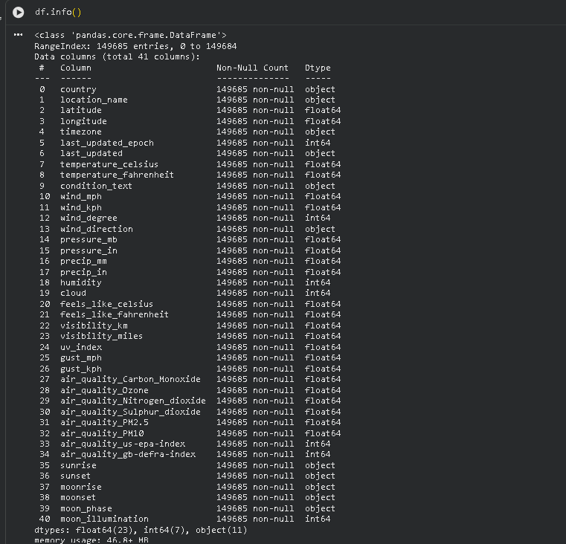
we used df.info() to see what data types are there

Slide 5
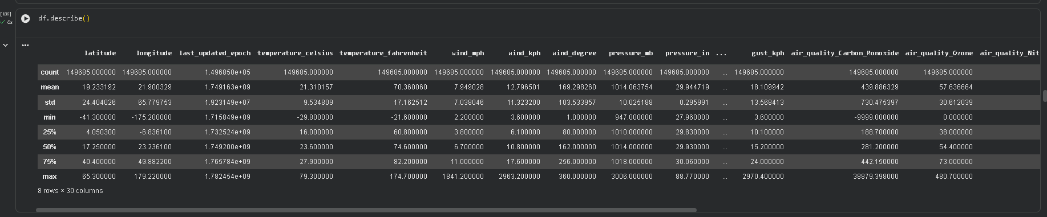
we use df.describe() to see various things like (mean , std, min) for our dataset across all the columns

Slide 6
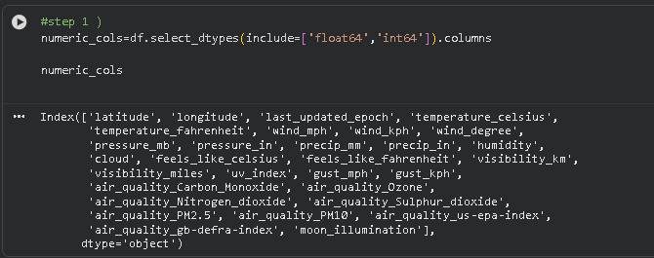
Data Cleaning and Preprocessing
Handle Missing Values
These are numeric columns

Slide 7
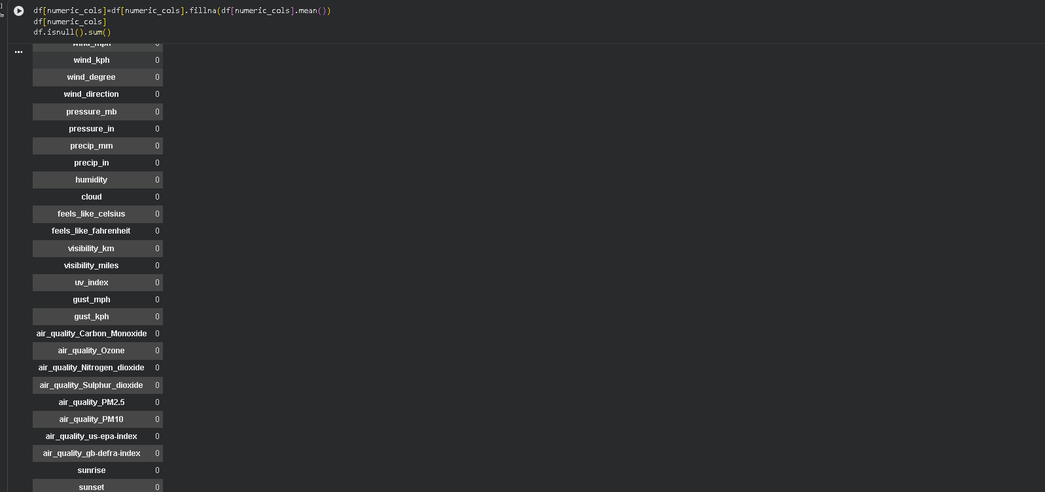
We fill using fillna function to handle missing values and fill that missing values with mean of numeric columns we check using .isnull() function and .sum() to show if there are missing values present in data we can see it is 0

Slide 8
We further check using .sum() values

Slide 9
We check if there any duplicate values in data or not

Slide 10
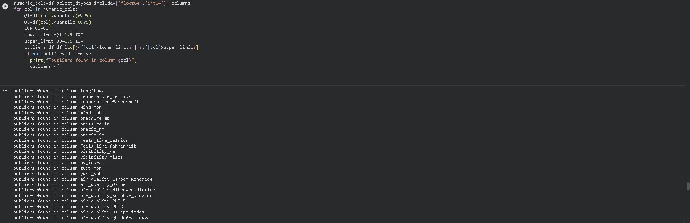
Handling Outliers what are outliers An outlier is a data point that is significantly different from the rest of the observations in a dataset.

Slide 11
How to calculate outliers
Q1=df[col].quantile(0.25)
Q3=df[col].quantile(0.75)
IQR=Q3-Q1
lower_limit=Q1-1.5*IQR
upper_limit=Q3+1.5*IQR
This is how we calculate IQR formula this is used to detect outliers

Slide 12
import pandas as pd
numeric_cols=df.select_dtypes(include=['float64','int64']).columns -> used to find numerical columns
for col in numeric_cols: -> looping through columns
Q1=df[col].quantile(0.25) -> 1st quantile
Q3=df[col].quantile(0.75) -> 3rd quantile
IQR=Q3-Q1
lower_limit=Q1-1.5*IQR
upper_limit=Q3+1.5*IQR
outliers_df=df.loc[(df[col]<lower_limit) | (df[col]>upper_limit)] -> filters the data to detect outliers
if not outliers_df.empty: -> if outliers are not found in the dataset print “outliers not found”
print(f"outliers found in column {col}")
outliers_df

Slide 13
df_cleaned=df.copy() ->
import numpy as np
numeric_cols=df.select_dtypes(include=['float64','int64']).columns
for col in numeric_cols:
Q1=df[col].quantile(0.25)
Q3=df[col].quantile(0.75)
IQR=Q3-Q1
lower_limit=Q1-1.5*IQR
upper_limit=Q3+1.5*IQR
df_cleaned[col]=np.where(df_cleaned[col]<lower_limit,lower_limit,df_cleaned[col])
df_cleaned[col]=np.where(df_cleaned[col]>upper_limit,upper_limit,df_cleaned[col])
df_cleaned

Slide 14
How did we handle outliers?
df_cleaned[col]=np.where(df_cleaned[col]<lower_limit,lower_limit,df_cleaned[col]).
df_cleaned[col]=np.where(df_cleaned[col]>upper_limit,upper_limit,df_cleaned[col]).
It checks if any value in the column (df_cleaned[col]) is less than your defined lower_limit. And replace it with lower_limit otherwise leave it completely alone .
It checks if any value in the column is greater than your defined upper_limit and replace it with upper_limit otherwise leave it completely alone .

Slide 15
Splitting the dataset why ?
We split the dataset into training and test data because it prevents data leakage . In simple words we don’t want the model to know the answers to questions.
Eg ‘sunny’ we don’t split the model recognize sunny memorizes specific rows , we get 100 percent accuracy . In real world we get ‘bad’,’rainy’ it will fail to predict
Eg if we split data 20 test set 80 training the data it figures out when humidity is low and temperature is high , answer is sunny.
If we deploy it to real world (20 hidden dataset) , we only give features say humidity and temperature , if it guesses sunny we can say that it has learned

Slide 16
from sklearn.model_selection import train_test_split
Imports train_test_split
x=df_cleaned.drop(columns=['condition_text’])
Drops the column name ['condition_text’] because this is the answer
y=df_cleaned['condition_text’]
Contains the answer like ‘sunny’, ’rainy’ which we will predict
x_train,x_test,y_train,y_test=train_test_split(x,y,test_size=0.2,random_state=42)
(x_train,) alongside with their correct answers (y_train) represent 80 percent of data upon which model will train
(x_test) Is hidden upon learning and see if prediction matches hidden answers (y_test) .This prevents data leakage .
random_state=42 ensures randomness so that you don’t get same specific rows each time we run the code

Slide 17
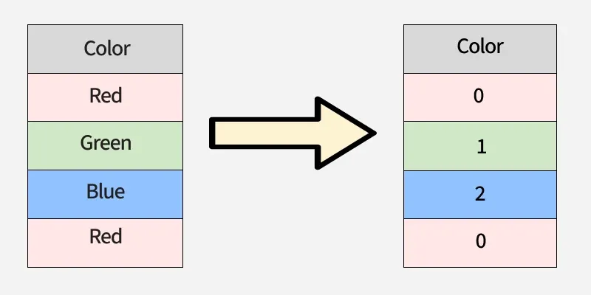
Handling the text columns
Since ml algorithms can run on text columns like ‘sunny’ etc we use encoding techniques such as one hot encoding or label encoding
To simplify we have used label encoding in our dataset

Slide 18
Scaling
If humidity ranges from 0 to 100 and pressure_mb range from 0 to 1000 the ml algorithm we get confused.
So we use techniques such as min max scaling,normalization so that dataset is within the range

Slide 19
Code for Scaling and Normalization
from sklearn.preprocessing import LabelEncoder, MinMaxScaler -> import LabelEncoder and MinMaxScaler
import pandas as pd
label_encoder = LabelEncoder() -> labelencoder project
y_train_ready = label_encoder.fit_transform(y_train) -> fit learns unique category and then transform( encoding)
y_test_ready = label_encoder.transform(y_test) -> translate test data into numbers suppose training data [‘cloudy’,’rainy’,’sunny’] ,[0,1,2]
If we use transform on testing data [‘rainy’,’sunny’]=[1,2] `, if we use fit_transform() it will ruin our data and give o/p [0,1]
scaler = MinMaxScaler() -> sets up minmaxscaler
numeric_features = x_train.select_dtypes(include=['float64', 'int64']).columns -> select numerical columns for scaling
x_train_ready = pd.DataFrame(scaler.fit_transform(x_train[numeric_features]), columns=numeric_features, index=x_train.index) ->fit(learn min max ) and transform(apply that to dataset ) , select numerical columns and reassign indexes so that we don’t lose our indexes
X_test_ready = pd.DataFrame(scaler.transform(x_test[numeric_features]), columns=numeric_features, index=x_test.index)-> learn and transform apply that to dataset ,don’t use fit to avoid data leakage and select numerical columns

Slide 20
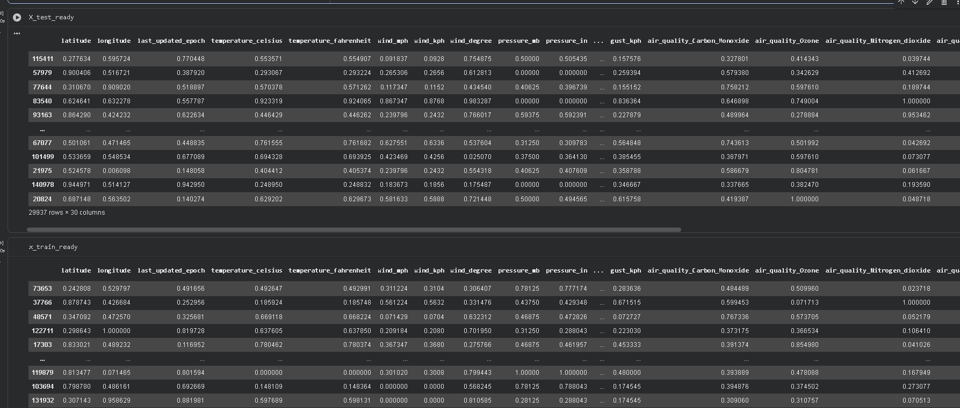

Slide 21
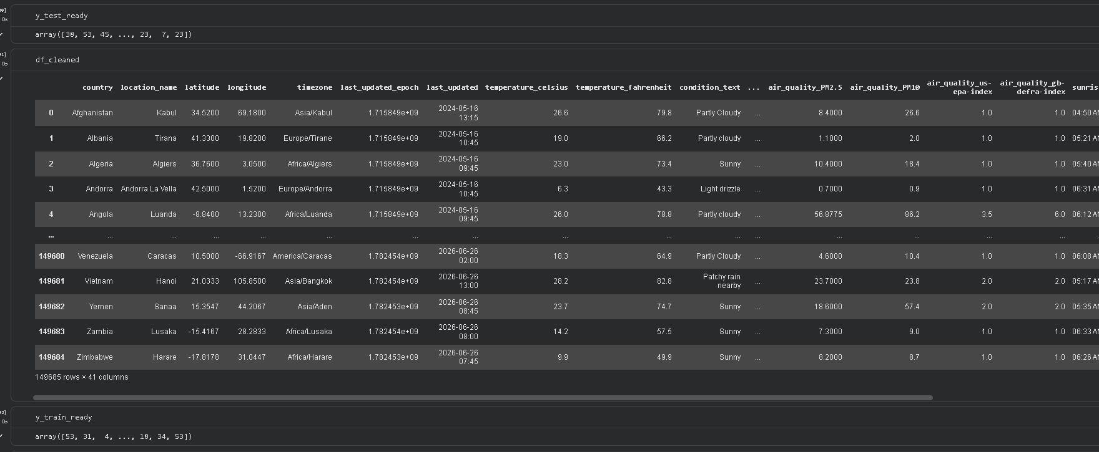

Slide 22
EDA
finding correlation between features visualization through libraries like matplotlib and seaborn and uncover trends and patterns

Slide 23
import matplotlib.pyplot as plt
import seaborn as sns
top_conditions = df_cleaned['condition_text'].value_counts().nlargest(5).index -> value-counts() each time weather conditions appear and when we run this code it returns a series sunny:120, rainy:80 when we add index it returns sunny, rainy etc (return labels) instead of value.counts( 150,80) etc
df_filtered = df_cleaned[df_cleaned['condition_text'].isin(top_conditions)] -> filtering the data first it will return a value of True and False wherever there is True Pandas keep that row and wherever there is False pandas delete that row
print("--- Value counts for top conditions ---")
print(df_filtered['condition_text'].value_counts()) -> returns value.counts()
plt.figure(figsize=(8, 5))
sns.countplot(
data=df_filtered,
x='condition_text',
palette='Set2',
order=top_conditions
)
plt.title('Top 5 Weather Categories')
plt.xlabel('Weather Condition')
plt.ylabel('Number of Records')
plt.xticks(rotation=15) -> rotate x label by 15 degrees so that it looks clean
plt.tight_layout() _> eliminates overlap , prevents label clipping
plt.show()

Slide 24
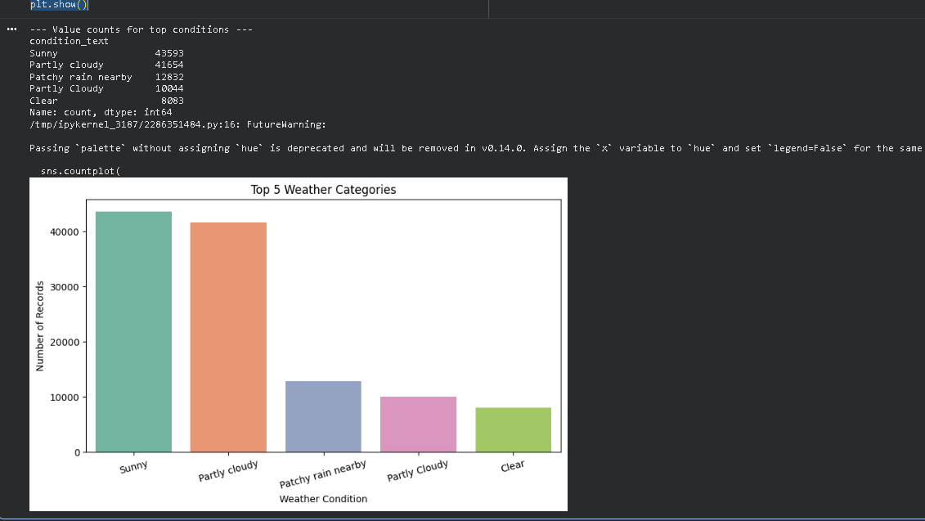

Slide 25
Code for boxplot between Temperature and Weather
import matplotlib.pyplot as plt
import seaborn as sns
top_conditions = df_cleaned['condition_text'].value_counts().nlargest(5).index –>same things returns the index labels and without their value_counts frequency
df_filtered = df_cleaned[df_cleaned['condition_text'].isin(top_conditions)]-> check true or false and return filtered row
plt.figure(figsize=(9, 5))
sns.boxplot(
data=df_filtered,
x='condition_text',
y='temperature_celsius',
palette='coolwarm',
order=top_conditions
)
plt.title('Temperature Ranges Across Top 5 Weather Conditions')
plt.xlabel('Weather Condition')
plt.ylabel('Temperature (°C)')
plt.xticks(rotation=15)
plt.tight_layout()
plt.show()

Slide 26
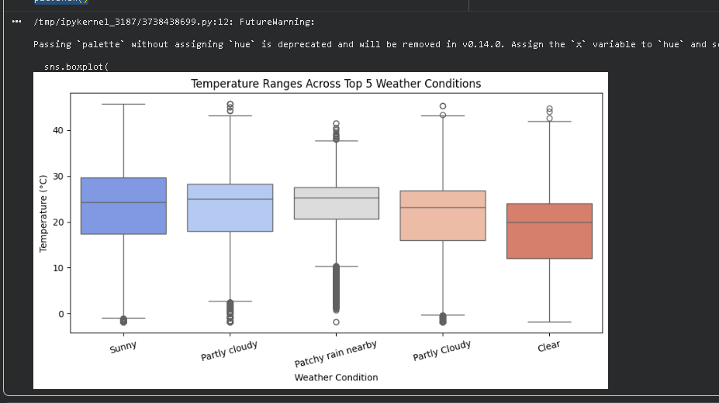

Slide 27
Code for Heatmap of correlation between numerical columns
numeric_data = df_cleaned.select_dtypes(include=['float64', 'int64'])
plt.figure(figsize=(9, 7))
sns.heatmap(numeric_data.corr(), annot=False, cmap='bwr', fmt=".2f", linewidths=0.5) ->corr() correlation between numerical columns ,annot writes exact corr score , colormap =blackwhitered and fmt shows decimal place upto 2 places and linewidth should be 0.5
plt.title('Feature Correlation Heatmap')
plt.show()

Slide 28
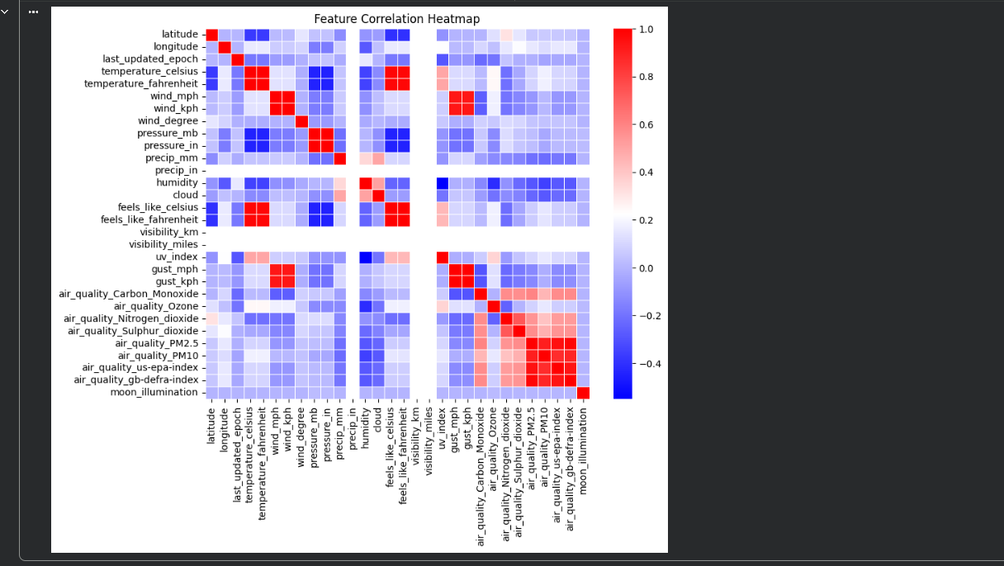

Slide 29
Code for chart between Percipitation and Weather
top_10_conditions = df_cleaned['condition_text'].value_counts(). Nlargest(10).index -> filters as same as previous
df_top_10 = df_cleaned[df_cleaned['condition_text'].isin(top_10_conditions)] ->filters as same as previous
plt.figure(figsize=(12, 6))
sns.barplot(
data=df_top_10,
x='condition_text',
y='precip_mm',
hue='condition_text',
legend=False,
palette='Blues_r',
errorbar=None
)
plt.title('Average Precipitation (Millimeters) for Top 10 Weather Conditions', fontsize=14, fontweight='bold')
plt.xlabel('Weather Condition', fontsize=12)
plt.ylabel('Average Precipitation (mm)', fontsize=12)
plt.xticks(rotation=45, ha='right’) -> ha=‘right’ each word is to the right to the corresponding tick
plt.tight_layout()

Slide 30
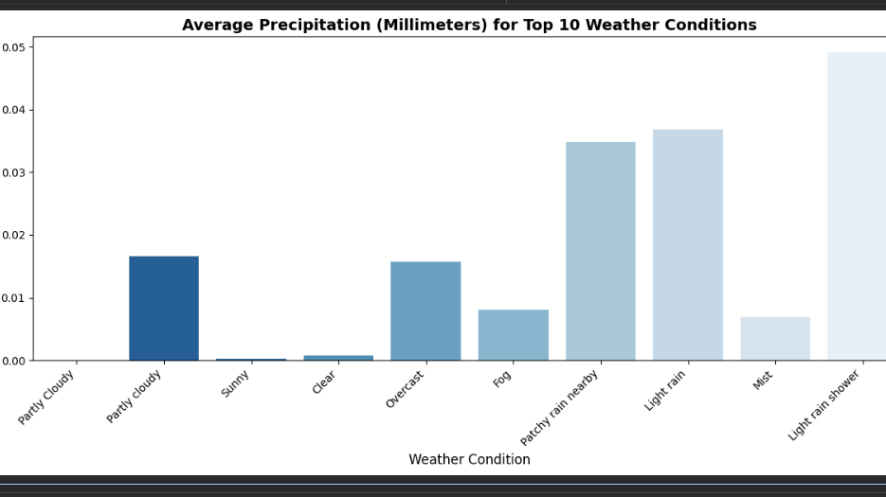

Slide 31
Model Building
For model building I Didn’t used XGBoost, RandomForest because they don’t work on time series analysis
For time series I used AutoARIMA as it automatically calculates time series data unlike in normal ARIMA where we have to define parameters this saves time

Slide 32
First, I have converted the last_updated data to time_series
#df['last_updated']=pd.to_datetime(df['last_updated’])->converts the object (text) into datetime format
#df['last_updated’]
#df.set_index('last_updated',inplace=True)->turns into index (time-series format)
print(df.index)-> print the timeseries as index
df

Slide 33
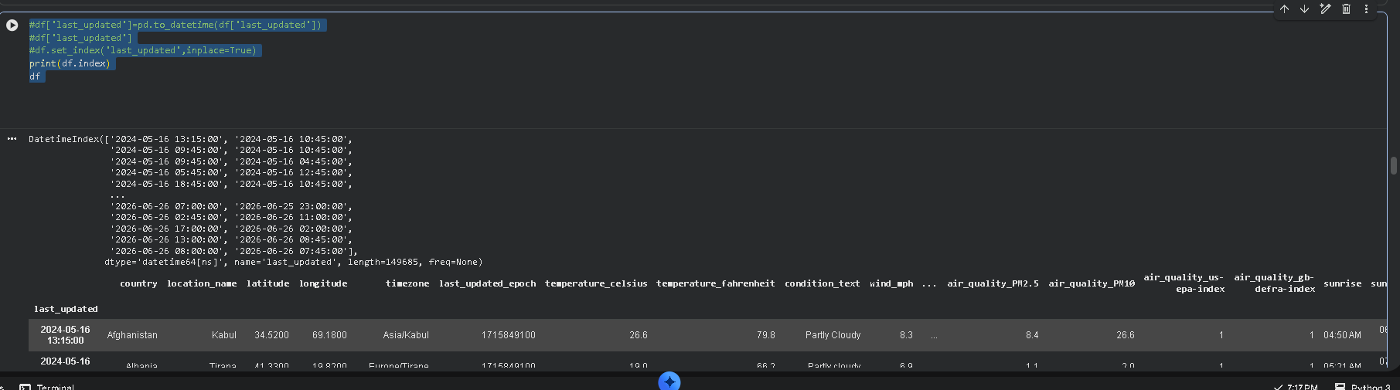

Slide 34
Model Building -1
import pmdarima as pm -> imports pmdarima library which automates time series forecasting
import pandas as pd -> imports pandas
df_vietnam = df[df['country'] == 'Vietnam'][['temperature_celsius']].copy() -> selects only those rows containing Vietnam
df_vietnam = df_vietnam.sort_index() -> sorts from oldest date to newest date to keep timeseries updated
df_vietnam = df_vietnam[~df_vietnam.index.duplicated(keep='first’)] ->discard duplicates and keep=first handle duplicates that have the same timeseries and keeps the rest dupicates as flagged
train_data = df_vietnam.iloc[:-5] ->keeps until the final 5 rows
actual_answers = df_vietnam.iloc[-5:] ->grabs only the final 5 rows
model_test = pm.auto_arima(train_data, seasonal=False, stepwise=True)
->Auto_arima tests different models automated search algo that acts like automated seasonal=false don’t look for comples repeating seasonal cycles . stepwise=True use an intelligent shortcut to find math formula
test_predictions = model_test.predict(n_periods=5)->predict the model and for 5 periods
average_degree_error = abs(actual_answers['temperature_celsius'].values- test_predictions.values).mean() ->abs clears out negative sign
average_degree_error ->

Slide 35
final_model = pm.auto_arima(df_vietnam, seasonal=False, stepwise=True) ->predict on real data
future_forecast = final_model.predict(n_periods=5)
print(future_forecast)-> print forecast

Slide 36
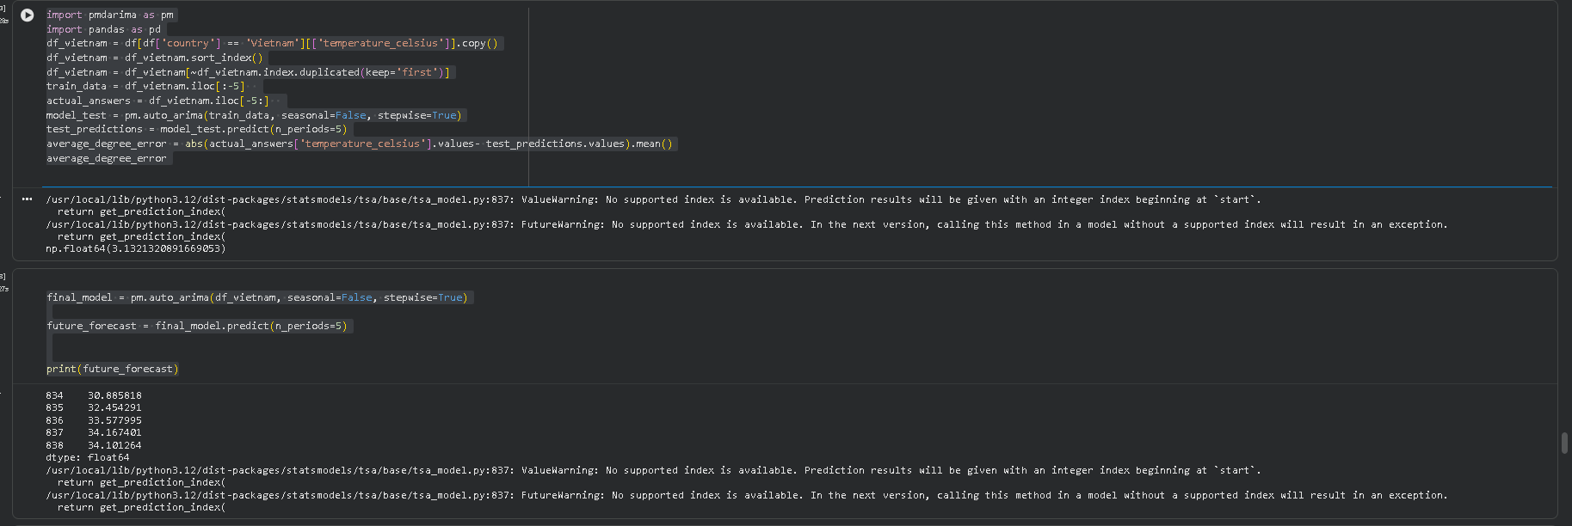

Slide 37
In the same way I have built the next 2 forecasting models for the different countries

Slide 38
Model Building-2
import pmdarima as pm
df_Angola = df[df['country'] == 'Angola'][['temperature_celsius']].sort_index()
df_Angola = df_Angola[~df_Angola.index.duplicated(keep='first')]
train_angola = df_Angola.iloc[:-5]
actual_answers_angola = df_Angola.iloc[-5:]
model_angola = pm.auto_arima(train_angola, seasonal=False, stepwise=True)
predictions_angola = model_angola.predict(n_periods=5)
average_error_angola = abs(actual_answers_angola['temperature_celsius'].values - predictions_angola.values).mean()
average_error_angola

Slide 39
final_model=pm.auto_arima(df_Angola,seasonal=False,stepwise=True)
future_forecast=final_model.predict(n_periods=5)
print(future_forecast)

Slide 40
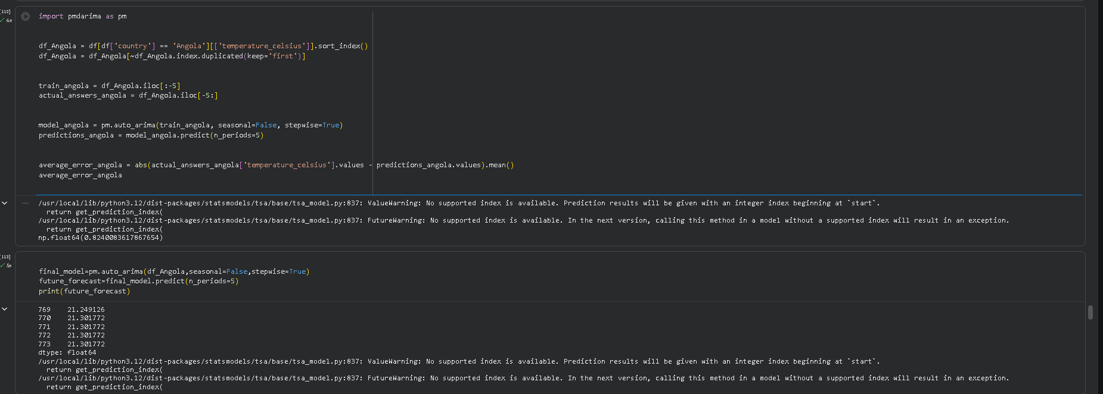

Slide 41
import pmdarima as pm
df_Angola = df[df['country'] == 'Angola'][['temperature_celsius']].sort_index()
df_Angola = df_Angola[~df_Angola.index.duplicated(keep='first')]
train_angola = df_Angola.iloc[:-5]
actual_answers_angola = df_Angola.iloc[-5:]
model_angola = pm.auto_arima(train_angola, seasonal=False, stepwise=True)
predictions_angola = model_angola.predict(n_periods=5)
average_error_angola = abs(actual_answers_angola['temperature_celsius'].values - predictions_angola.values).mean()
average_error_angola

Slide 42
final_model=pm.auto_arima(df_Angola,seasonal=False,stepwise=True)
future_forecast=final_model.predict(n_periods=5)
print(future_forecast)

Slide 43
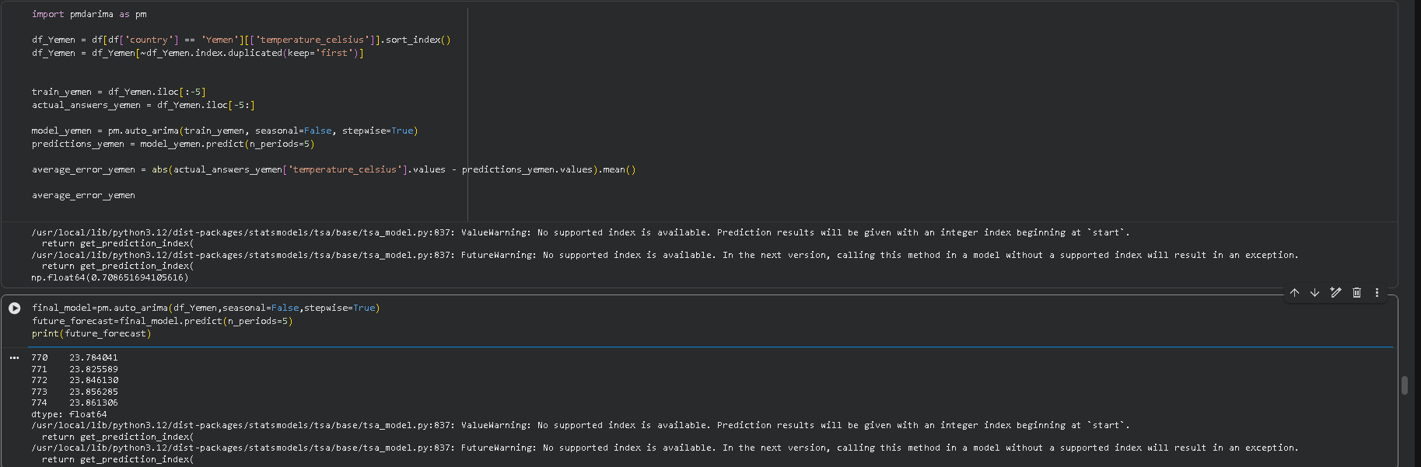

Slide 44
Anomaly Detection
We detect using Anomalies using Isolation Forest Algorithm
We run isolation forest on error points instead of raw data points as it misses Anomalies on raw data
Eg Temp 44c in winter . A human would see Anomaly but Isolation Forest would treat as normal .

Slide 45
Anomaly Detection
import pandas as pd
import numpy as np
import pmdarima as pm
from sklearn.ensemble import IsolationForest -> imports IsolationForest Algorithm
df_vietnam = df[df['country'] == 'Vietnam'][['temperature_celsius']].sort_index()-> filters only those rows belonging to vieitnam
df_vietnam = df_vietnam[~df_vietnam.index.duplicated(keep='first’)]-> keeps first occurrence of duplicates
arima_model = pm.auto_arima(df_vietnam, seasonal=False, stepwise=True)->calculate skips heavy seasonal steps and use intelligent step by step shortcut to calculate steps
predicted_temperatures = arima_model.fittedvalues() ->fittedvalues() commands the model to look back at historical timeline and output what temperature It expects to see each day
df_vietnam['model_error'] = df_vietnam['temperature_celsius'] - predicted_temperatures -> actual_temp- pred_temp
X_errors = df_vietnam['model_error'].values.reshape(-1, 1) ->skicit-Learn's models strictly require input data to be structured rather than a list
iso_forest = IsolationForest(contamination=0.03, random_state=42) -> flag top 3 most isolated features and random_state=42 introduces randomness
df_vietnam['anomaly_score'] = iso_forest.fit_predict(X_errors) -> run iso_forest on errorrs
model_anomalies = df_vietnam[df_vietnam['anomaly_score'] == -1] -> detect anamlaies
model_anamalies

Slide 46
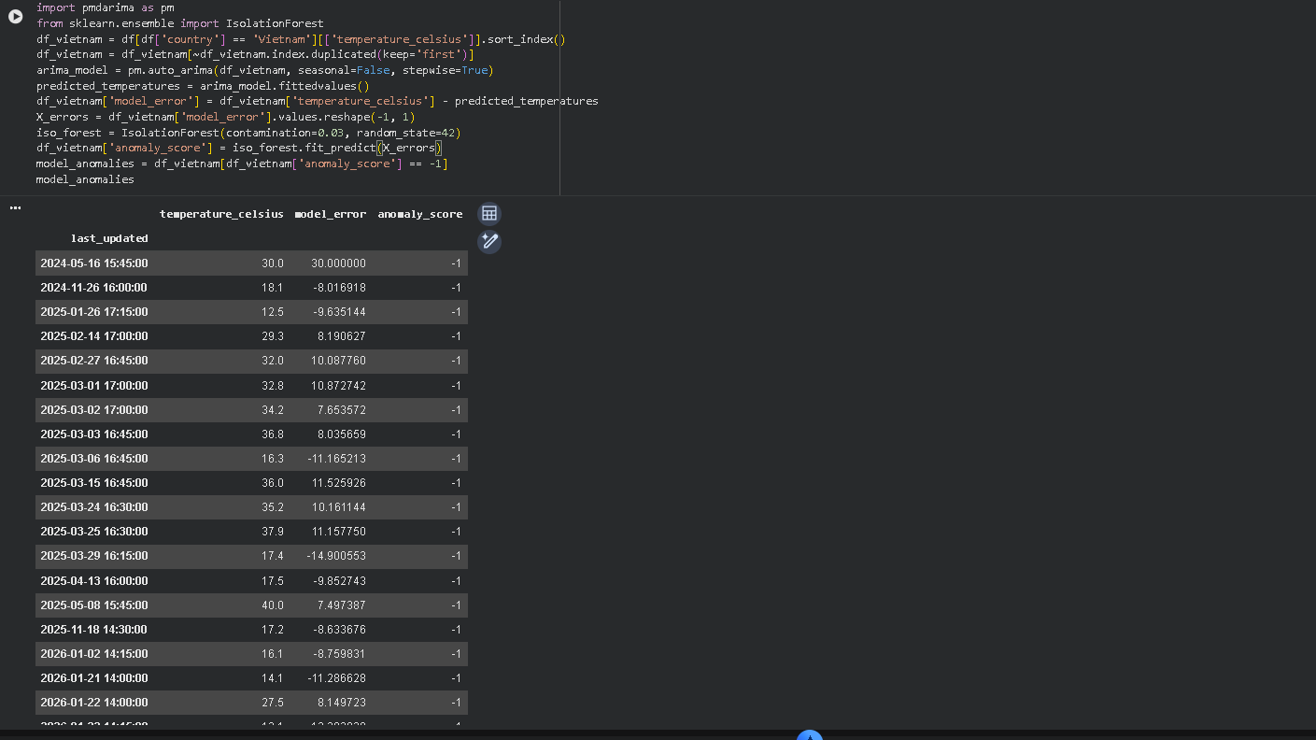

Slide 47
Feature Importance
from sklearn.inspection import permutation_importance ->how important each feature is to the model prediction
labels = df_vietnam['anomaly_score’]-> saving it to the feature called labels
result = permutation_importance(iso_forest, X_errors, labels, scoring='accuracy’) -> detecting important features using permutation_importance
print(result.importances_mean) -> print result_importances.mean

Slide 48
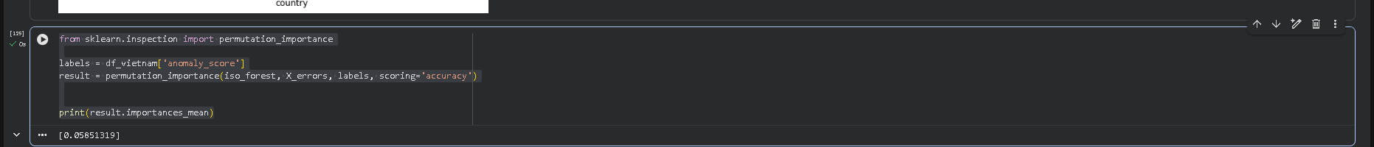

Slide 49
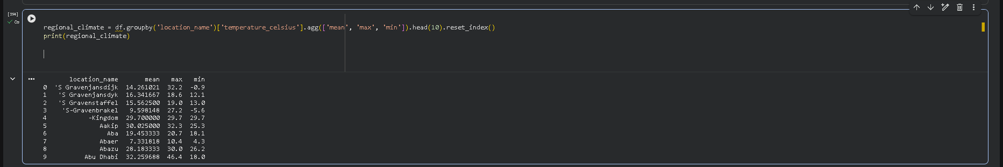
Climate Analysis
regional_climate = df.groupby('location_name')['temperature_celsius'].agg(['mean', 'max', 'min']).head(10).reset_index() -> group by and calculate air_quality metrics
print(regional_climate) -> print the regional climate

Slide 50
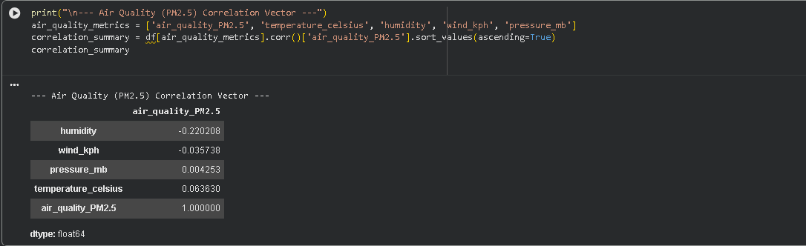
Air Quality
print("\n--- Air Quality (PM2.5) Correlation Vector ---")
air_quality_metrics = ['air_quality_PM2.5', 'temperature_celsius', 'humidity', 'wind_kph', 'pressure_mb']
correlation_summary = df[air_quality_metrics].corr()['air_quality_PM2.5'].sort_values(ascending=True)

Slide 51
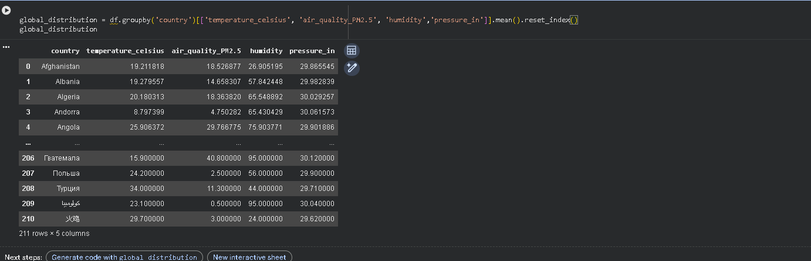
Spatial Analysis: Analyze and visualize geographical patterns in the data.

Slide 52
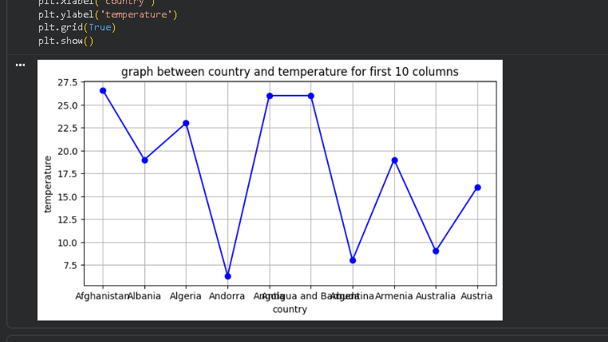

Slide 53
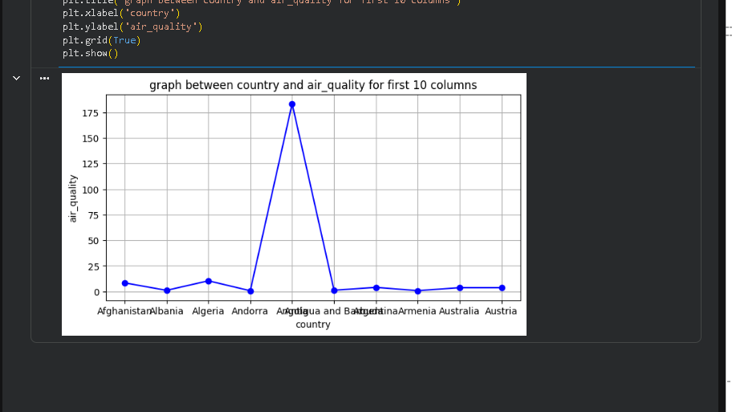

Slide 54
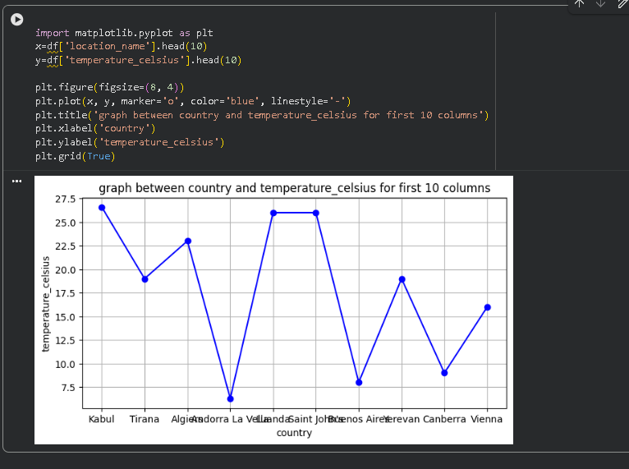
Geographical Patterns: Explore how weather conditions differ across countries and continents.

